Slide 1
Info 201
Lab 4

Slide 2
Homework 5
Due 11/01
Content
Using github API
R Markdown

Slide 3
APIs

Slide 4
Review: API Concepts in a nutshell
Usually Transfer information via HTTP
Facilities Web Queries of Content
Generally you:
Go to a url asking for something
The url will then send you the information you want

Slide 5
Let’s get some review/practice

Slide 6
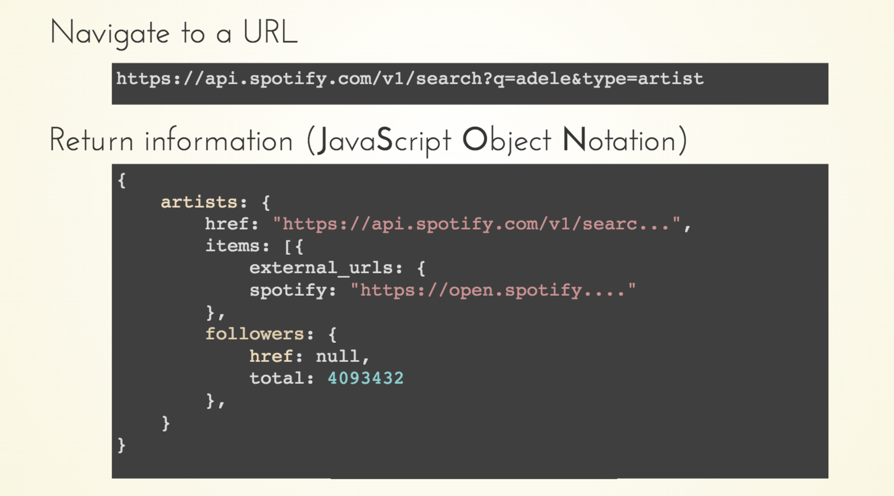

Slide 7
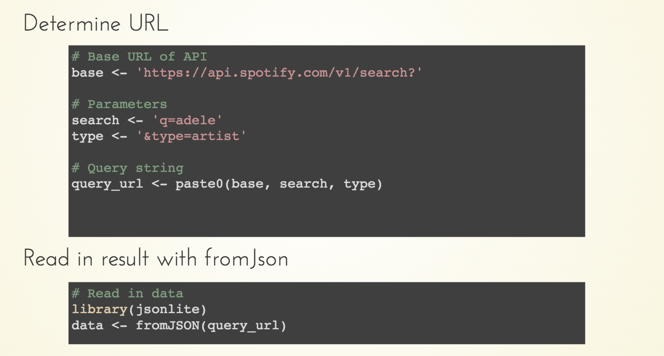

Slide 8
2
Lab Exercise
Notes:
Link in title. Just click and go.

Slide 9
Don’t forget...
Homework 5 due 11/01
Homework 3 returned on 10/25
Questions?
Modules
Google
Neighbor
Then after all that...
Ask your TA
Slack
Email

